Slide 1

Revenue Prediction
By Angela Jackson

Slide 2
What is the purpose behind this prediction?
The goal behind analyzing this dataset is to determine which parameters yield the highest results.
Sources GoogleAdWord, GoogleSearch, and Directlink are observed to see which sources can produce the highest revenue
In doing so MSE and SVM are the functions used to see which parameters show the most significance for our prediction

Slide 3
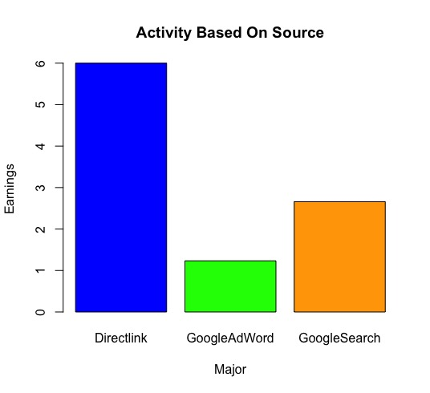
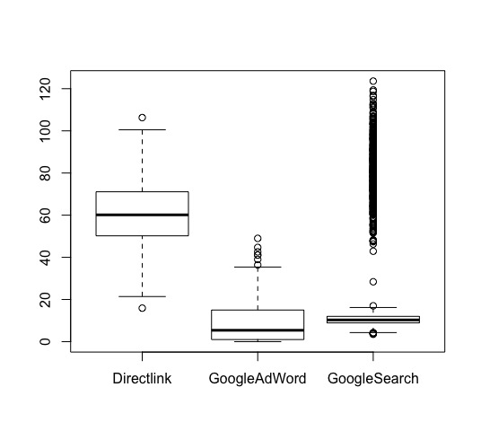
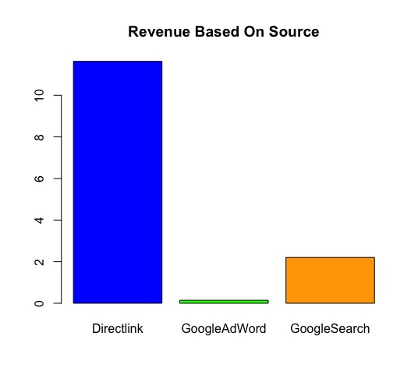
Plots
Here illustrates several plots based on activity, revenue and duration from these three website sources.
Based on the results it appears Directlink has the highest overall revenue, activity and duration compared to its competitors like GoogleSearch and GoogleAdWord.
R Code:

Slide 4
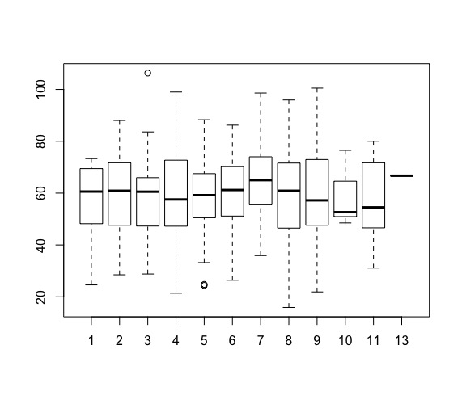
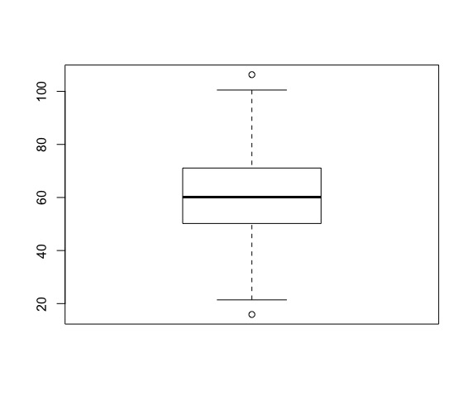
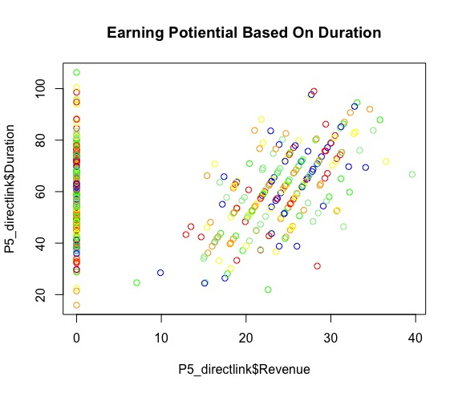
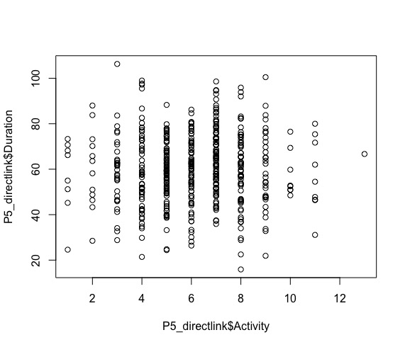

Direct Link Plots
These plots provide an overview on which plots show the most significance. In the image in the upper left corner
The boxplot to the right and left show a great amount of significance from revenue, activity and source.
In bottom left and right plots it is shown revenue and activity is crucial component for Directlink. There are clear signs of linear growth between both plots.
This shows the intial barplots show the data’s
R Code:

Slide 5
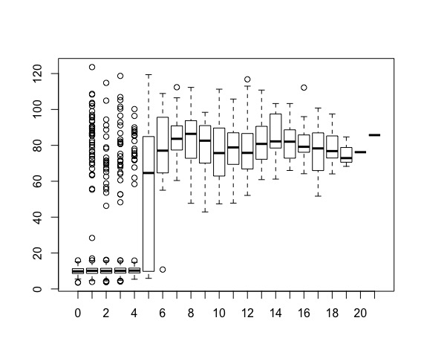
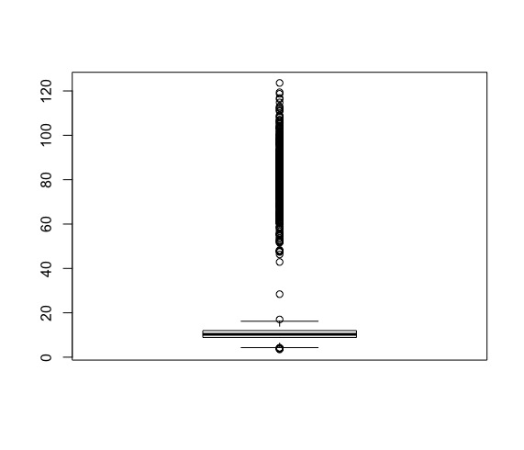
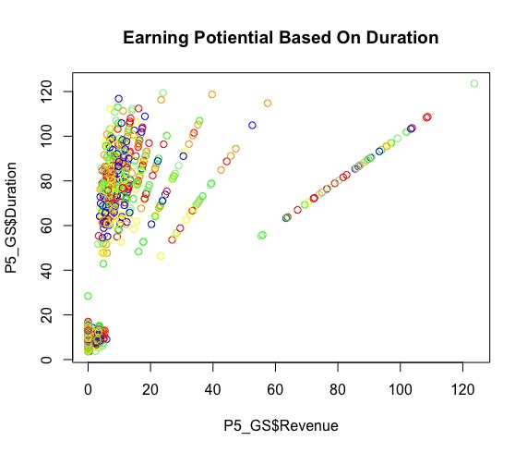
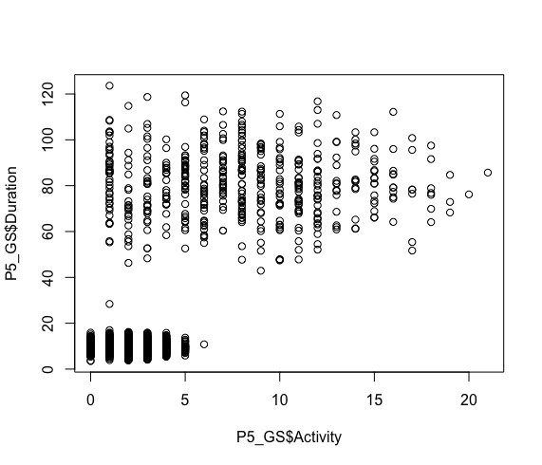
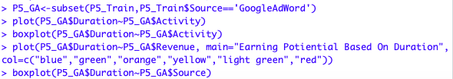
Google Search Plots
The illustration to the far left tells us there is not much linear growth up until 5 when there is an increase. This growth is not continuous as it gradually decreases all the way down to 20.
Earning potential is very scattered showing very little growth based on duration.
In the bottom right, activity and duration is much more sporadic in activity and duration.
However, revenue and duration show little signs of exponential growth
R Code

Slide 6
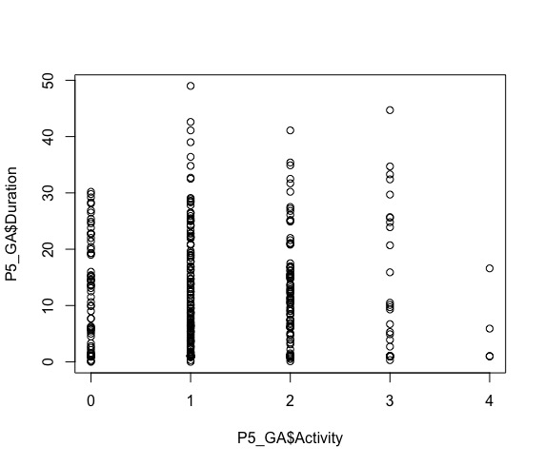
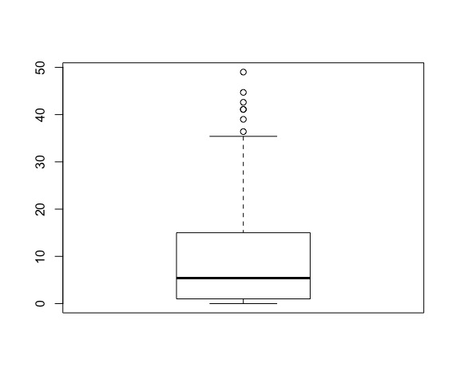
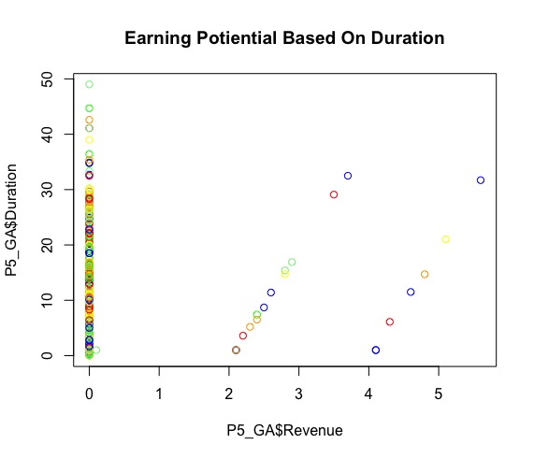
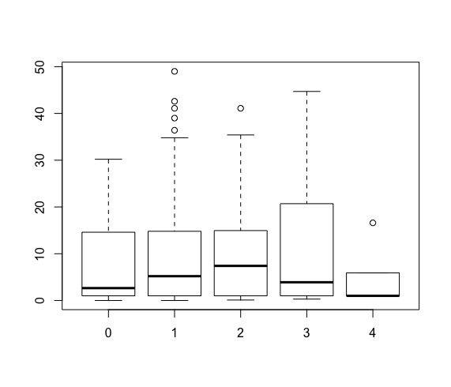
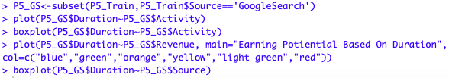
Google Ad Word Plots
The plots here tell us there is some significance from GoogleAdWords in terms of linear growth.
The Activity and Duration appear to be uniformed together with little variation.
Surprisingly revenue and duration did not show a significant increase. Aside from the outliers, there is minimal growth.
R Code:

Slide 7
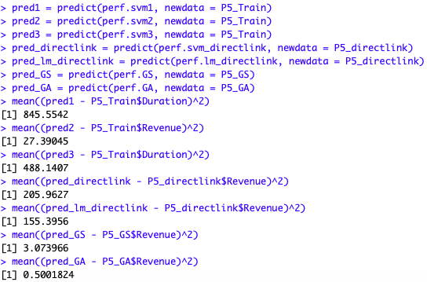
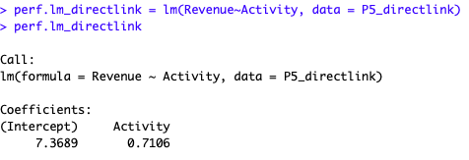
SVM & LM
Functions SVM and & LM were best suitable for this dataset as MSE was not efficient to achieve
Linear model was used to calculate the X and Y axis in directlink, GoogleAdWord, and GoogleSearch. The goal was to see the relation between attributes for all three sources used.
In doing so gave the mean for all three sources to the right;

Slide 8
What Does The Average Tell Us ?
The mean or average, tell us that using the Linear model for GoogleAdWords gave a better predication rate of 0.500.
GoogleSearch had a prediction rate of 3.07 and Directlink had a prediction rate of 155.396.
Directlinks prediction rate of 155.396 isn’t bad, initially it was 27.03, but after some adjusting it eventually increased overtime.
GoogleSearch low score rate tells us the average person is not browsing through Google as often compared to its counterparts such as Directlink and GoogleAdWords.

Slide 9
Conclusion
For this dataset given for three sources to see which source overall prediction rate.
GoogleSearch yielded a significant loss with barely any growth from the data
GoogleAdWords had a moderate exponential growth, but not by very much
Directlink showcased the highest in all categories for revenue, duration and source. It seems more people are interested in being on Directlink than GoogleAdWords or GoogleSearch.
Overall Directlink upheld the best results

